Slide 1

EDA: Body Composition and Workout Routines Analysis for Gym Members to Optimise Physical Fitness
This report delves into an exploratory data analysis of gym members body composition and workout routines. The goal is to identify key factors influencing physical fitness and provide recommendations for optimising the body composition of all gym members.

Slide 2
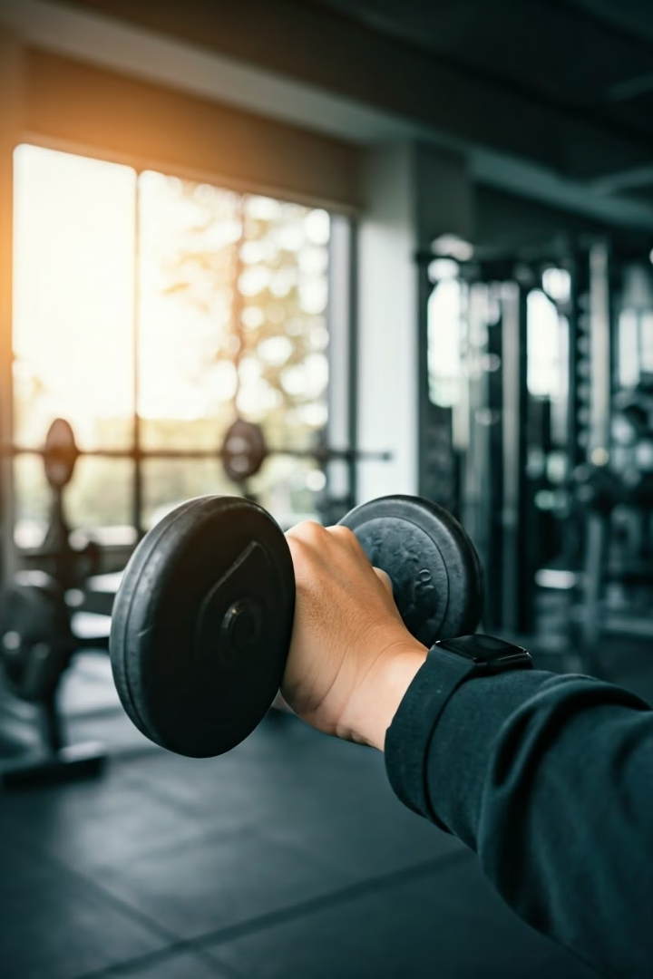
Introduction to the study and its objectives
1
Study Scope
2
Data Analysis
The study aims to understand the relationship between body composition, workout routines, and physical fitness outcomes for gym members.
This involves exploring data collected on members body composition metrics and workout routines to identify key factors influencing fitness.
3
Optimising Workout Programmes
The analysis will provide valuable insights for developing personalised workout routines to enhance gym members' overall body composition.

Slide 3

Data collection process and key variables
Variable
Description
Age
Member's age in years
Gender
Male or Female
Height
Member's height in meters
Weight
Member's weight in kilograms
Body Fat Percentage
Percentage of body mass that is fat
Body Mass Index (BMI)
It is calculated by dividing a person's weight in kilograms by the square of their height in meters
Workout Frequency
Number of gym visits per week
Calories Burned
Total calories burned during each session
Workout Type
Type of workout performed

Slide 4
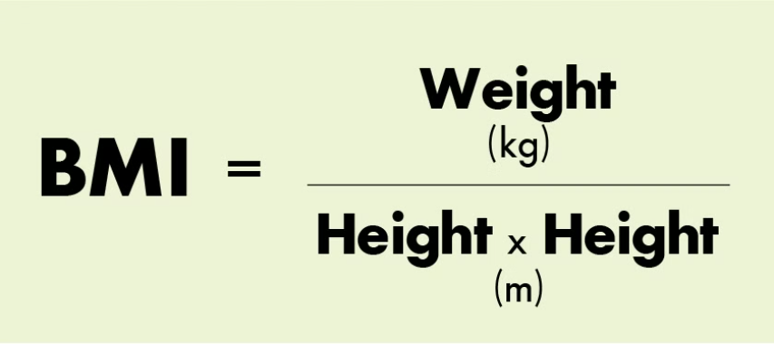
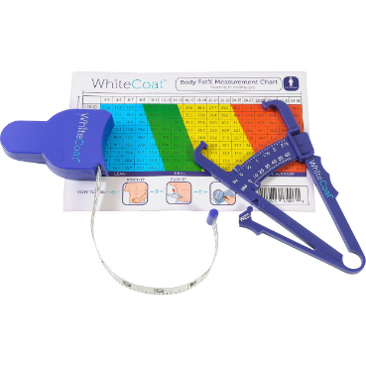
Exploratory analysis of body composition metrics
Body Mass Index (BMI)
The BMI categories are standard for both men and women:
Underweight: BMI < 18.5
Normal weight: BMI 18.5–24.9
Overweight: BMI 25–29.9
Obesity: BMI ≥ 30
Body Fat Percentage
Healthy Body Fat % for Men by Age:
Ages 20-39: 8-19%
Ages 40-59: 11-21%
Ages 60-79: 13-24%
Healthy Body Fat % for Women by Age:
Ages 20-39: 21-32%
Ages 40-59: 23-33%
Ages 60-79: 24-35%

Slide 5

Data Cleaning: BMI and Body Fat Percentage
Incongruent Record Filtering
First of all, creation of a code that identifies and removes inconsistent records from the dataset based on:
BMI and Fat Percentage Mismatch: Eliminates "Underweight" records with high fat or "Obesity" records with low fat.
Unrealistic Values: Filters out entries with extreme fat percentage (<3% or >50%), weight (<30 kg or >200 kg), and height (<1.2 m or >2.5 m).
This ensures the dataset is accurate and reliable for analysis.

Slide 6
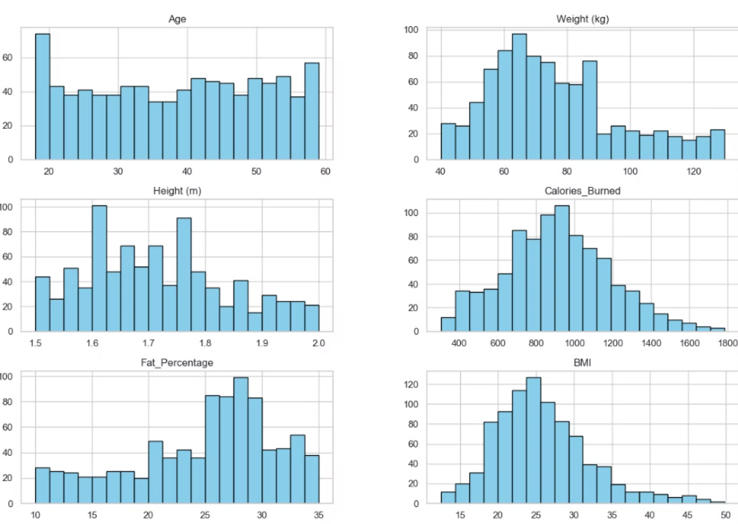
Data Distribution and Removal
The initial dataset contained 973 imputs for each single gym member with it's metrics. Total records removed: 93; Underweight with High Fat: 92; Obesity with Low Fat: 1 , leaving the data distribution aprox. 50% males and females as in origin. Leaving the dataset like this with the main variables we are working on as shown below but Gender and Workout_Frequency (days/week)

Slide 7
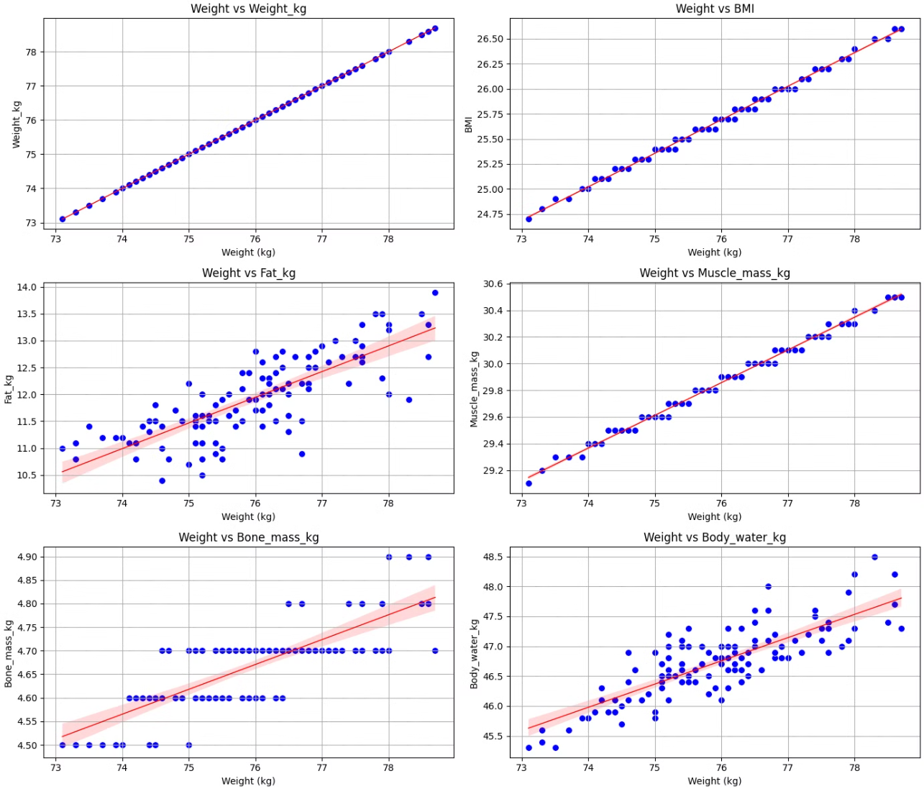
Member Body Composition
Analysis Over 4 Months
This analysis explores the body composition changes over time for a single gym member just to check the relevance and relation of BMI, Weight and Fat as on our dataset we only have single records for each gym member.
The analysis focuses on six key body composition metrics: BMI, Weight body fat percentage, lean body mass, and waist-to-hip ratio, tracked over a period of four months.

Slide 8
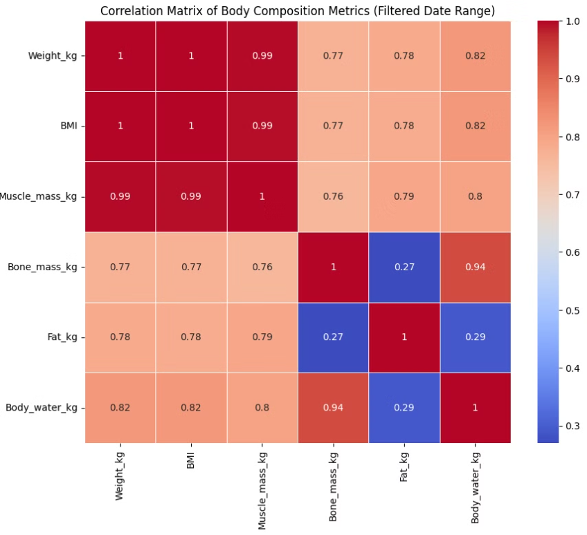
Correlation Matrix of Body Composition
The correlation matrix helps understand relationships between different body composition metrics. Strong positive correlations suggest variables move in the same direction, while negative correlations suggest opposite movements.
This matrix reveals a stronger positive correlation between BMI and muscle mass than fat, indicating that this individual seems to have a high muscle mass. It also shows a light correlation between body water and fat, which is common as fat mass contains about 10-20% water, while lean mass (such as bone and muscle) has around 70-75% water.

Slide 9
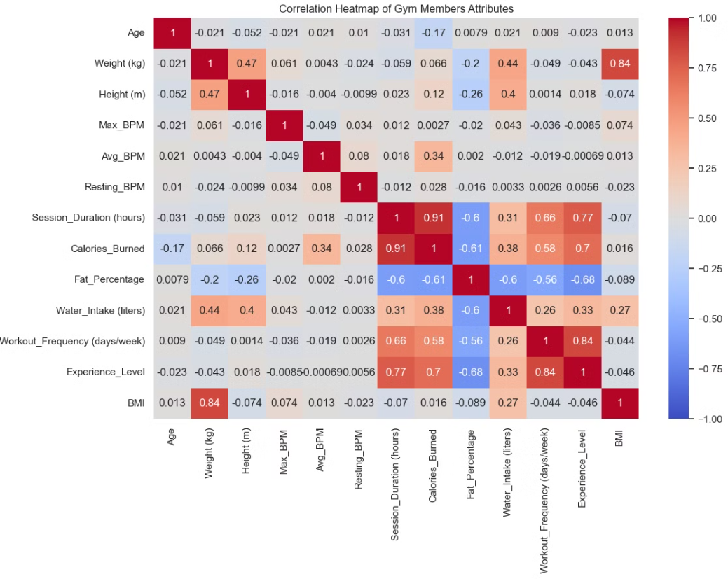
Correlation Matrix of All Gym Members
This correlation matrix analyses the relationship between different body composition metrics for all gym members. It helps to identify key relationships between factors like calories burned, fat percentage, and workout frequency. Understanding these correlations can help optimise workout routines and provide personalised fitness recommendations.

Slide 10
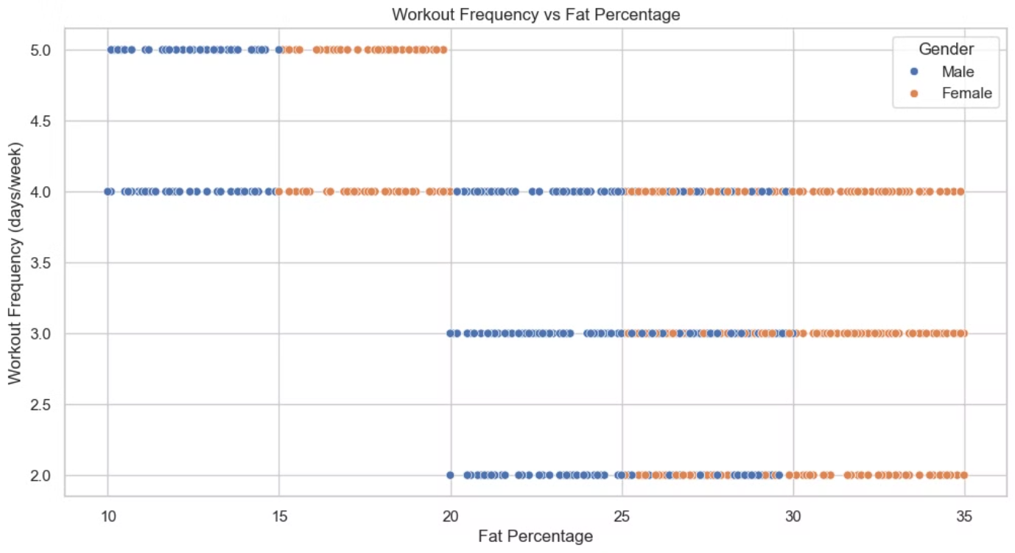
Workout Frequency and Body Fat Percentage
The chart shows the average body fat percentage for gym members based on their workout frequency. As expected, the average body fat percentage tends to decrease with more frequent workouts.

Slide 11
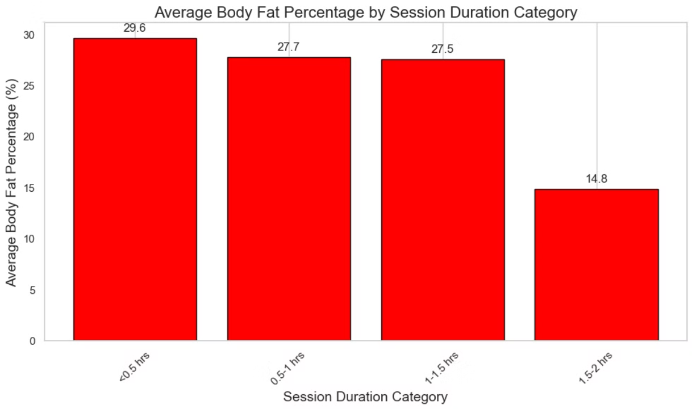
Relationship between Workout Duration and Body Fat Percentage
The chart shows the relationship between gym session duration and average body fat percentage. Members who participate in longer sessions tend to have lower body fat percentage, suggesting a correlation between workout duration and fat reduction.

Slide 12
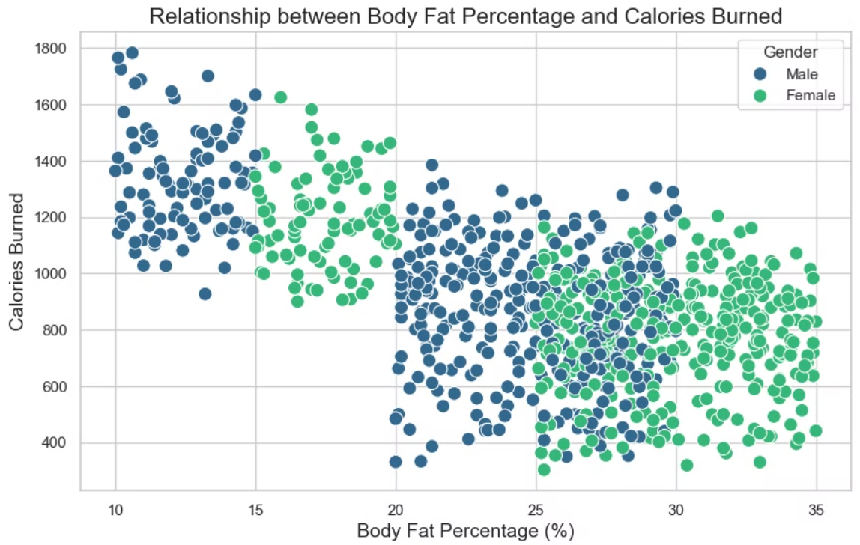
Calories Burned and Body Fat Percentage
The chart explores the relationship between calories burned and body fat percentage. It shows the body fat percentage of each gym member for different levels of calories burned per sesion. This allows us to see how the two are connected and to identify that the intesity of the workout is crucial in lowering the body fat.

Slide 13
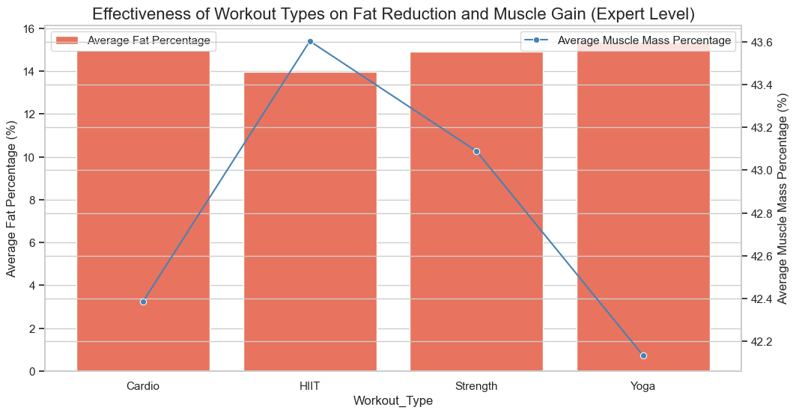
Best workouts to gain muscle and lose fat
The chart explores the relationship between different workout types and muscle mass and fat percentage on average of the expert members of the gym .

Slide 14




Identifying key factors influencing physical fitness
Workout Frequency
Consistent workout frequency is a significant factor influencing physical fitness, as it provides regular opportunities for calorie expenditure and lowering fat mass.
Workout Duration
Longer workout sessions allow for greater calorie expenditure and fat loss, contributing to improved fitness levels.
Workout Intensity
Higher intensity workouts lead to greater calorie burn and metabolic benefits, resulting in more significant fitness improvements like fat loss.

Slide 15

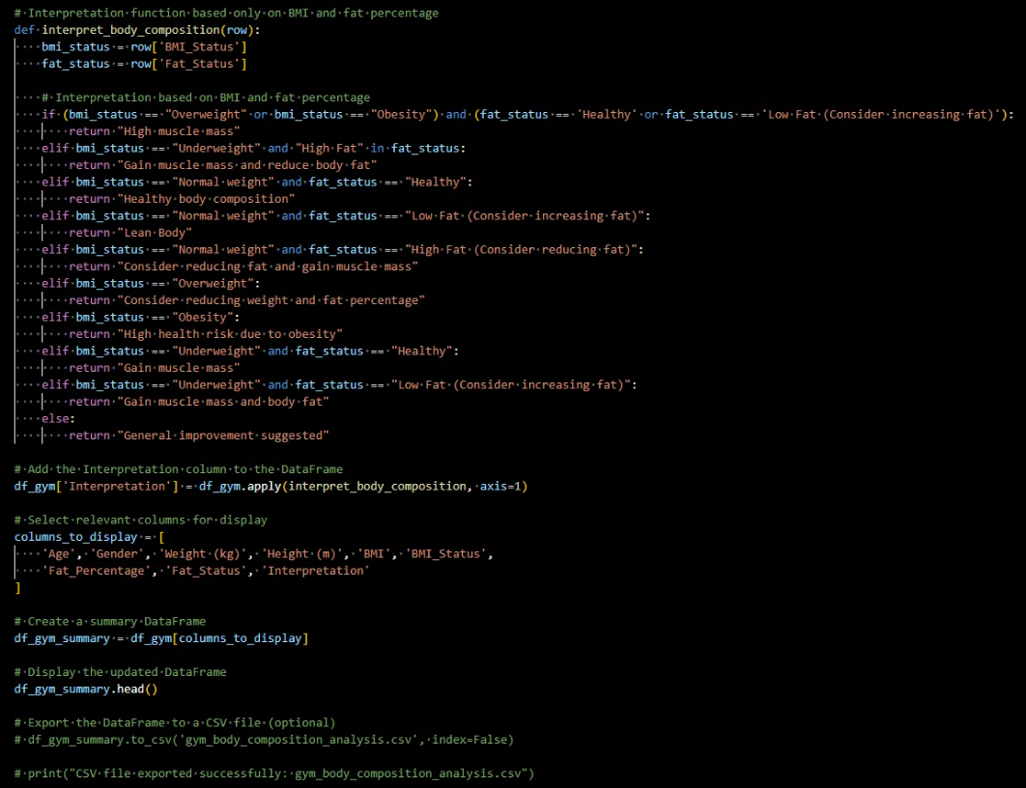
Body composition interpreter and workout advisor for optimising workout routines

Slide 16
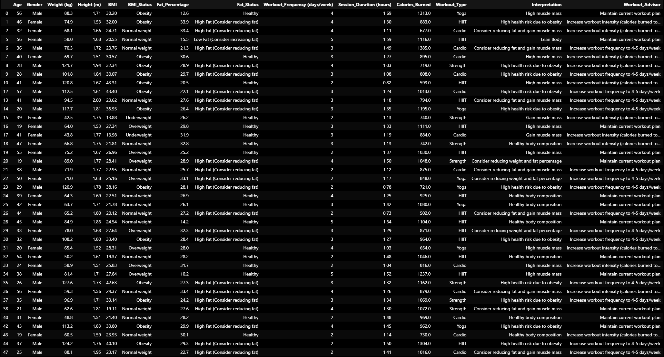

Slide 17
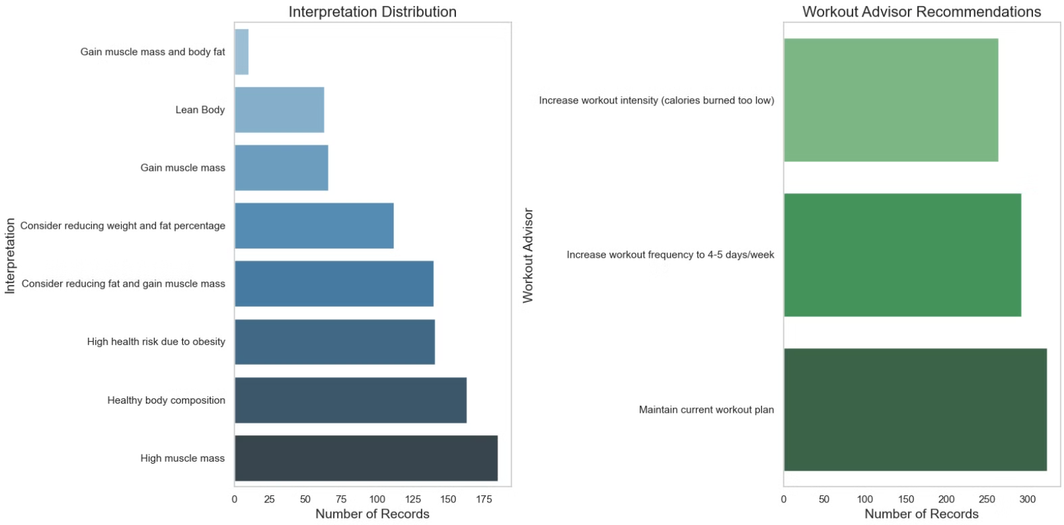

Slide 18




Limitations and future research directions
Sample Size and data limitations
The analysis may be constrained by a relatively small sample size, which could limit the generalizability of the results. Additionally, the absence of key health metrics such as muscle mass, waist measurements, blood analysis, blood pressure, and other critical indicators reduces the ability to draw comprehensive conclusions about overall health and fitness.
Longitudinal Data
Future research could benefit from collecting longitudinal data to observe long-term impacts of workout programmes on physical fitness.
Dietary Factors
Including dietary data in future research would provide a more comprehensive understanding of factors influencing physical fitness.

Slide 19

Conclusion and key takeaways
1
Workout Frequency and Intensity
2
Individualized Approach
Regular, high-intensity workouts contribute significantly to improved physical fitness and body composition.
Tailoring workout programmes to individual needs and goals is essential for maximizing fitness outcomes.
3
Continued Research
Further research with larger sample sizes and longitudinal data can provide deeper insights into the relationship between workout routines and physical fitness.

Slide 20
Thank you for your attention
Source Code and Data
LinkedIn Profile
View the code and data used for this analysis on Github.
Connect with Mikel Telo on LinkedIn to discuss the analysis in more detail.
https://github.com/MikelTelo/eda_for_gym_owners_members
https://www.linkedin.com/in/mikel-telo-a96a371a/

